Slide 1

Expense Manager
By
Nithin George
22PMC140

Slide 2

Abstract
Expense Manager helps users track and control their expenses effectively.
Expense Manager simplifies expense management with intuitive features.
Users can effortlessly record expenses and monitor their financial health in real-time.
Expenses are categorized based on personal requirements, giving users insights into spending patterns and areas for improvement.
Expense Manager provides visualizations and reports, summarizing financial data for easy analysis.
Expense Manager is user friendly.

Slide 3

Project Requirements
1. Record and categorize expenses
2. Budget Tracking
3. Calendar view
4. Export options of the expense
5. Export options of the income
6. Profile management
7. Mobile view
8. Admin dashboard
9. Set a custom Currency

Slide 4

Features and Highlights
Ability to add, edit, and view expenses with categorization options.
Users can view income and expenses as graphs for different categories.
A Customized Calendar view that gives the summary of income and expense of each day.
Users can export the data of expenses and incomes whenever required.
Project is designed in such a responsive manner that users you use this web app in their mobile phones as well.

Slide 5

Architecture of the project
The architecture of the Expense Manager project follows a layered and modular design, incorporating key components and their interactions to provide an efficient expense management system.
Presentation Layer:
User Interface: It handles the user interaction and provides a user-friendly interface for accessing the application.
Views and Forms: It comprises the screens and forms that allow users to input expenses, set budgets, and view reports.
Application Layer:
Expense & Income service: It acts as the core functionality of the system, handling expense and income recording, categorization etc.
User Service: It manages user-related operations such as user authentication, user registration, and profile management.
Reporting Service: It generates various types of reports based on expense data.

Slide 6
Architecture of the project
3. Data Layer:
Database: It includes a relational database management system called SQLite to store user data, expense records, budgets, and other relevant information.
Object-Relational Mapping (ORM): An ORM tool is used to map database entities to application objects, facilitating data retrieval and manipulation.
4. Integration Layer:
External APIs: This component integrates with external systems, such as FullCalendar APIs or Chart Js APIs, to visualize the transaction data automatically.
5. Reporting and Analytics:
Reporting Engine: This component generates reports and visualizations based on user preferences and selected data parameters.

Slide 7
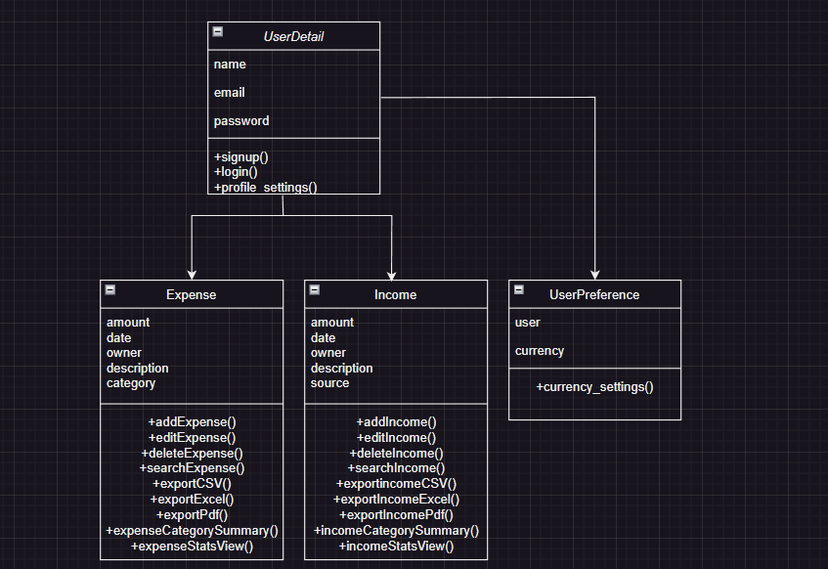
Class Diagram of the project

Slide 8







Third Party libraries & API’s
Django-jazzmin : It is used at the admin page to provide a responsive design.
CSS-Bootstrap 5 : It is used to create a consistent and professional looking user interface.
PDF Generation – ReportLab : It is used to generate PDF documents programmatically.
Visualisation- ChartJs : It is used for creating interactive and visually appealing charts and graphs.
CSV: It is used to export data as CSV.
XLWT: It is used to export data as Excel.
FullCalendarJs : It is used to display calendar to render events.

Slide 9


Challenges faced during development
Implementing FullCalendarJs to the application system.
Implementing ChartJs to the application system.
Providing a user-friendly interface.
Ensuring accuracy and compliance.
Developing a cross platform compatible system.
Performance optimizations.

Slide 10
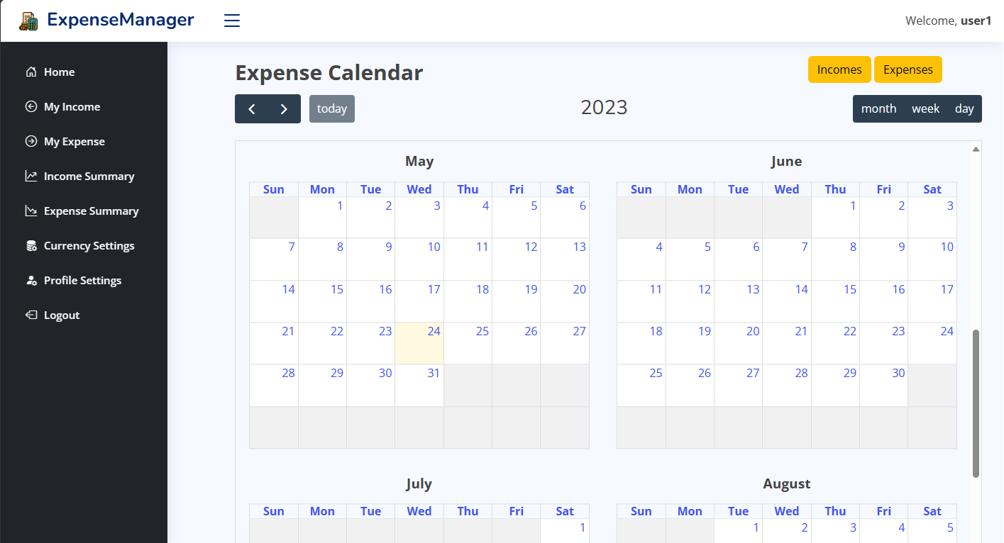
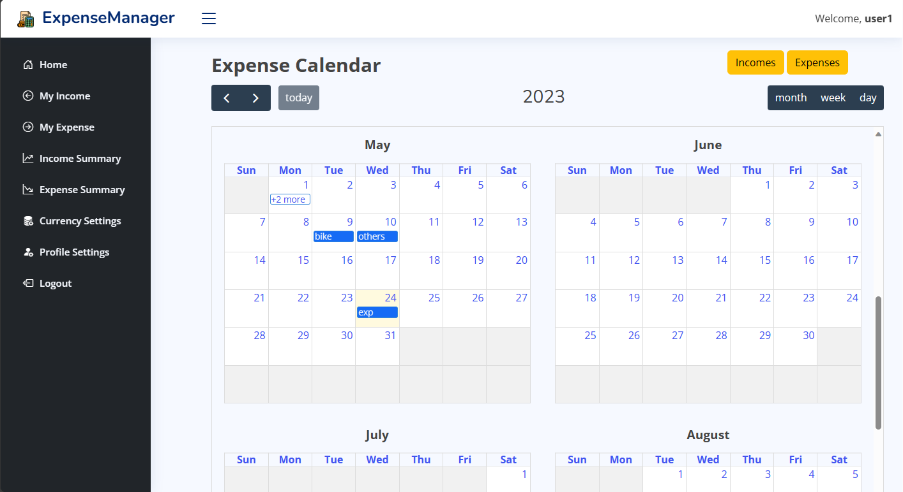
Screenshots
This is the home page which displays a calendar and two buttons marked within the red rectangle which shows the income and expenses of each month as a summary in two separate calendars. The second screenshot is an example of how the expenses are displayed as summary. Likewise, we can see the summary of income as well. Moreover, we can change the view of calendar to month, day and week format.

Slide 11
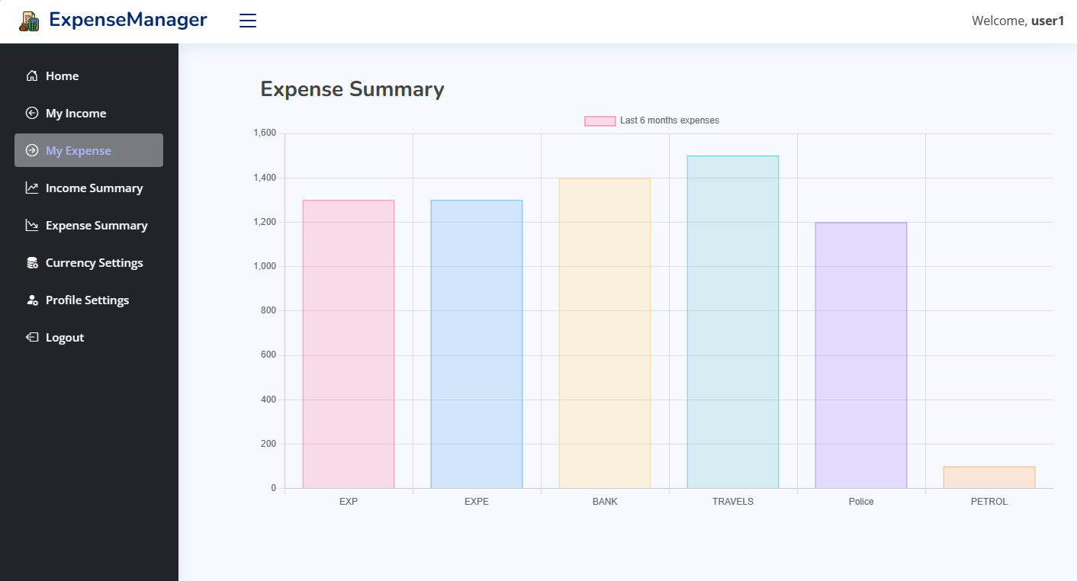
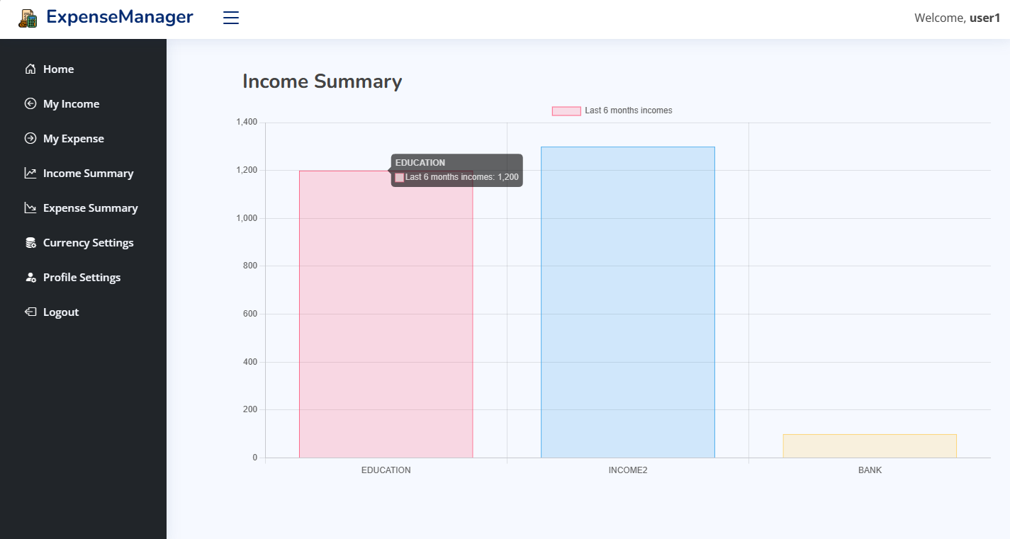
Screenshots
The two screenshots shows the Expense and Income Summary as bar charts respectively which are distinguished on the basis of categories that the user has entered. The charts are displayed on the basis of last 6 months expenses and incomes respectively.

Slide 12
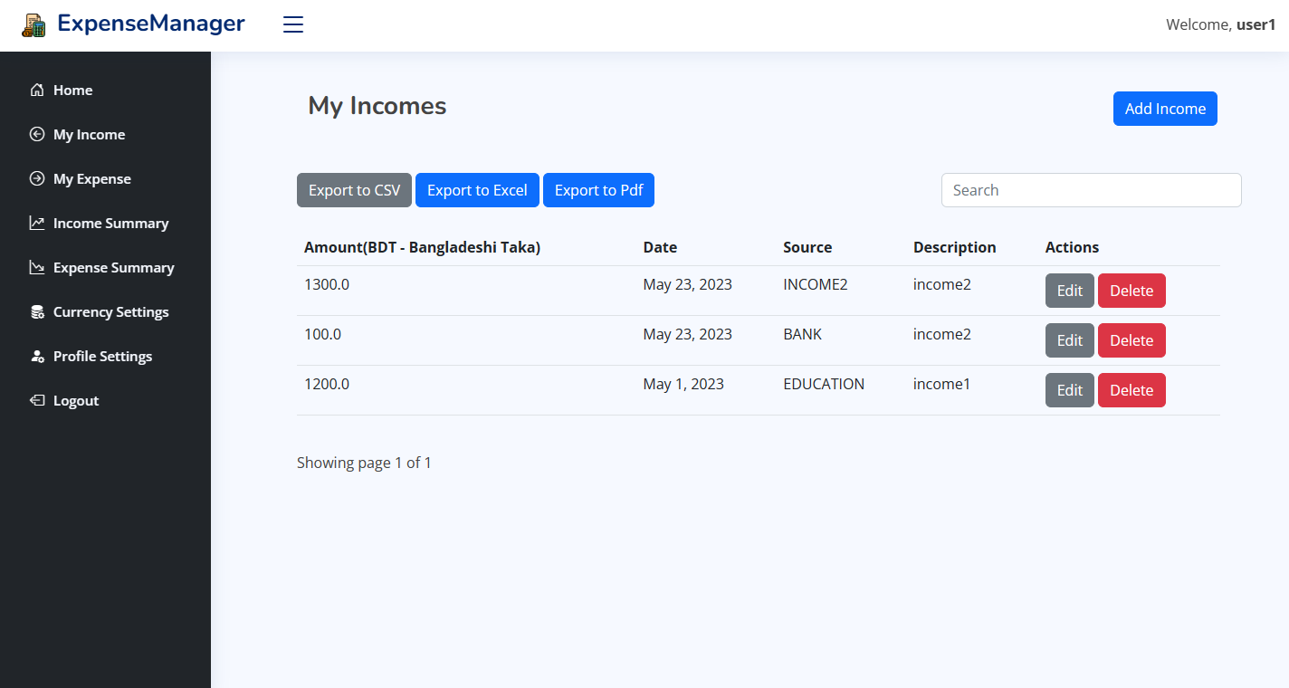
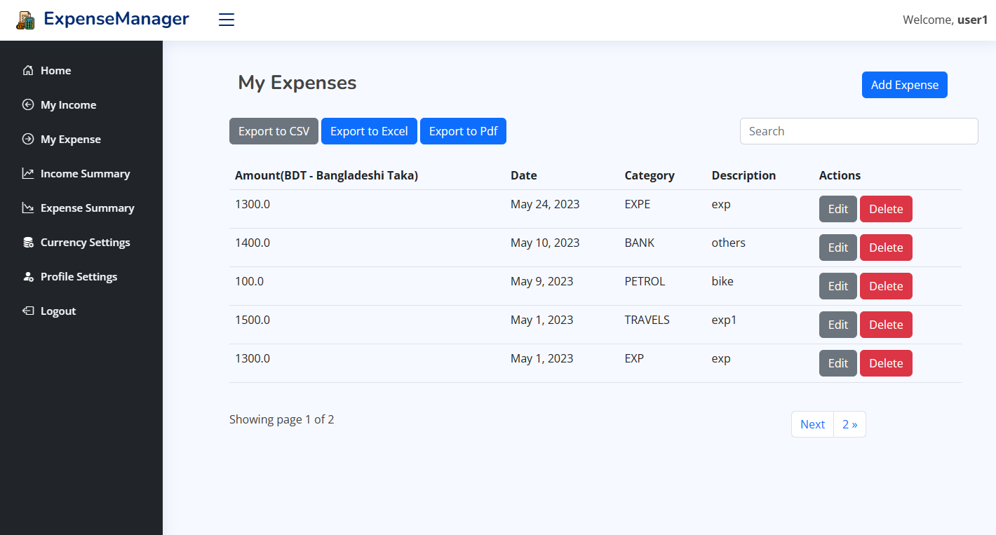
Screenshots
The two screenshots shows the Income and Expenses entered by the user such that the following page lets users add, edit and delete incomes and expenses. Moreover, User could export the data as CSV, Excel or to Pdf formats as per their requirements.

Slide 13

Future Enhancements
As Future Enhancements, I would like to add features like:
Budget limit exceed alerts.
Automated income and expense insertion.
Customization on income and expense summary.
Live Currency conversion rates.
Ability to convert expenses and incomes based on conversion rates.
Import feature for expense and Income from excel.
Smart budget recommendation from analysis on previous transactions.
Smart Receipt Scanning
Bill reminders from various receipts.

Slide 14
Conclusion
The Expense manager is a powerful tool that simplifies and enhances personal expense management.
With its user-friendly interface and robust features, users can effortlessly track, categorize, and control their expenses, leading to better financial health and improved financial well-being.
With insightful visualizations and reports, the application provides users with clear and concise summaries of their financial data.
It is a valuable tool for individuals seeking to gain control over their finances, achieve their financial goals, and improve their overall financial well-being.

Slide 15

References
Live Project Demo: https://nithingeorge2000.pythonanywhere.com/
ChatGPT
FullCalendar Js documentation
Chart Js documentation
Django documentation

Slide 16

Thanks!
Nithin George
georgenithin180@gmail.com
+91 9497304051

